Slide 1

Dalas Presentation : Why do some football teams dominate their leagues?
Antoine Théologien, Armand Bonn
M1 DAC
2024-2025

Slide 2
Introduction and motivations
Some teams are winning more than others : Why ?
Key factors of a football club success
Data Analysis and predictions

Slide 3
OUR DATA
Top 5 championships
Matches Results and events
Clubs data : Players value, age…
Focus on 3 seasons : from 2021 to 2024

Slide 4
First feature : Market value
Obvious but true : money creates victory
For every championship, richest clubs finish higher
But not a guarantee !

Slide 5
Investment in defense : not a great solution
If defense value higher than attack value : less goal scored
Prioritize investments in attackers or midfielders
Which kind of players should be bought ?

Slide 6
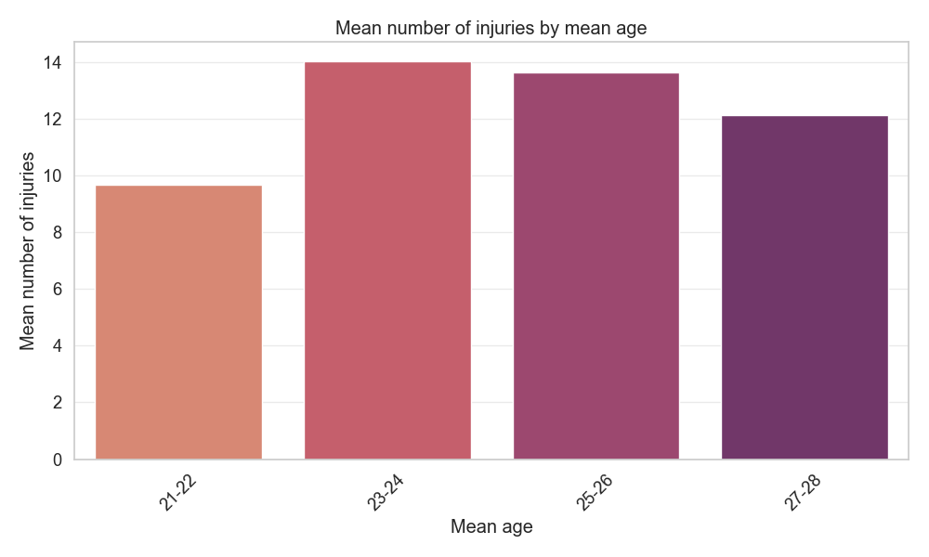
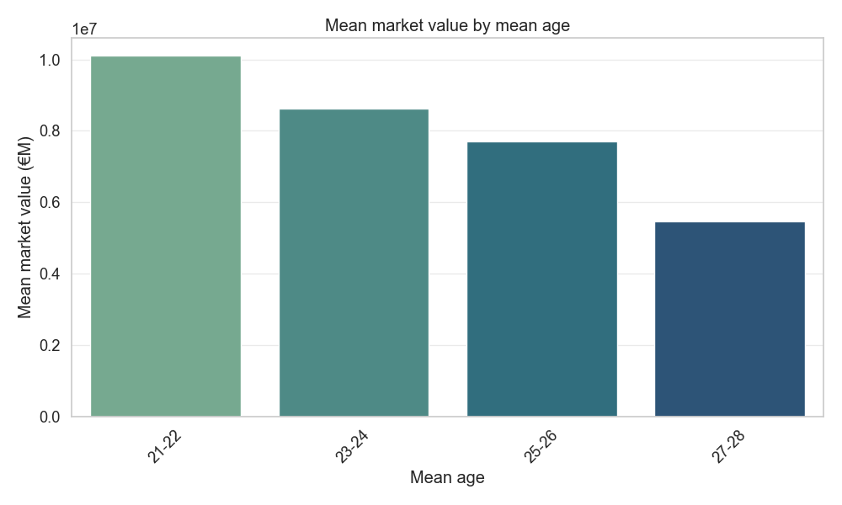
Focusing on young players : not that useful
They also cost much more than the older ones
Young players are not particularly prone to injuries

Slide 7
Conclusion

Slide 8

Questions

Slide 9
Bilbiography
Bordes, A., Usunier, N., Garcia-Duran, A., Weston, J., and Yakhnenko, O. (2013). Translating embeddings formodeling multi-relational data. In Burges, C., Bottou, L., Welling, M., Ghahramani, Z., and Weinberger,K., editors, Advances in Neural Information Processing Systems, volume 26. Curran Associates, Inc.
Devlin, J., Chang, M.-W., Lee, K., and Toutanova, K. (2019). Bert: Pre-training of deep bidirectionaltransformers for language understanding.
Ge, X., Wang, Y. C., Wang, B., and Kuo, C.-C. J. (2023). Compounding geometric operations for knowledgegraph completion. In Rogers, A., Boyd-Graber, J., and Okazaki, N., editors, Proceedings of the 61stAnnual Meeting of the Association for Computational Linguistics (Volume 1: Long Papers), pages 6947–6965, Toronto, Canada. Association for Computational Linguistics.
Li, M., Hu, M., King, I., and Leung, H.-f. (2024). The integration of semantic and structural knowledge inknowledge graph entity typing. In Proceedings of the 2024 Conference of the North American Chapter ofthe Association for Computational Linguistics: Human Language Technologies (Volume 1: Long Papers),page 6625–6638. Association for Computational Linguistics.
Moon, C., Jones, P., and Samatova, N. F. (2017). Learning entity type embeddings for knowledge graphcompletion. In Proceedings of the 2017 ACM on Conference on Information and Knowledge Management,CIKM ’17, page 2215–2218, New York, NY, USA. Association for Computing Machinery.
Sun, Z., Deng, Z.-H., Nie, J.-Y., and Tang, J. (2019). Rotate: Knowledge graph embedding by relationalrotation in complex space.
Trouillon, T., Welbl, J., Riedel, S., ´Eric Gaussier, and Bouchard, G. (2016). Complex embeddings for simplelink prediction.
Zhao, Y., Zhang, A., Feng, H., Li, Q., Gallinari, P., and Ren, F. (2020). Knowledge graph entity typing vialearning connecting embeddings. Knowledge-Based Systems, 196:105808.

